Slide 1

Rating-PREDICTION
Predicting the Star rating for reviews of ecommerce websites

Slide 2
Contents
Problem Statement
EDA Steps & Visualization
Methodology
Modelling
Conclusion

Slide 3
Problem Statement
The problem is related to one such client who has a website where people write different reviews for technical products. Now they are adding a feature to the website
Where the reviewer will have to add the stars(rating) as well with the review. The rating is out of 5 starts and it only has 5 options available ie 1star, 2 star 3 star, 4 star and 5 star. Now they want to add a rating for the reviews written in the past but they don’t have a rating . So we need to build an application which can predict the rating by seeing the review.
The Internet has revolutionized the way we buy products. In the retail e-commerce world of online marketplace, where experiencing products are not feasible. Also, in today’s retail marketing world, there are so many new products are emerging every day. Therefore, customers need to rely largely on product reviews to make up their minds for better decision making on purchase. However, searching and comparing text reviews can be frustrating for users. Hence we need better numerical ratings system based on the reviews which will make customers purchase decision with ease.
During their decision-making process, consumers want to find useful reviews as quickly as possible using rating system. Therefore, models able to predict the user rating from the text review are critically important. Getting an overall sense of a textual review could in turn improve consumer experience. Also, it can help businesses to increase sales, and improve the product by understanding customer’s needs.

Slide 4
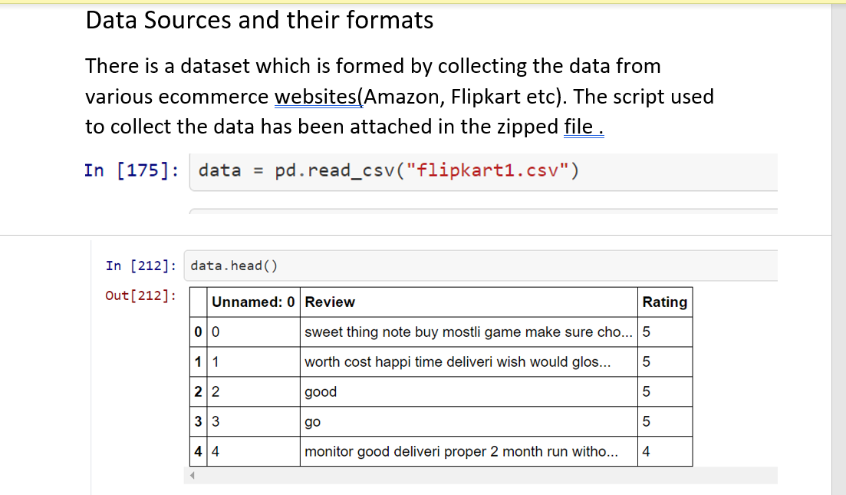
Exploratory data analysis
Import csv: Loading the data

Slide 5
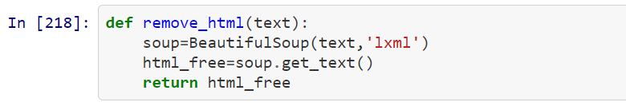
Data Preprocessing
Removing the HTML Tags If ANY

Slide 6
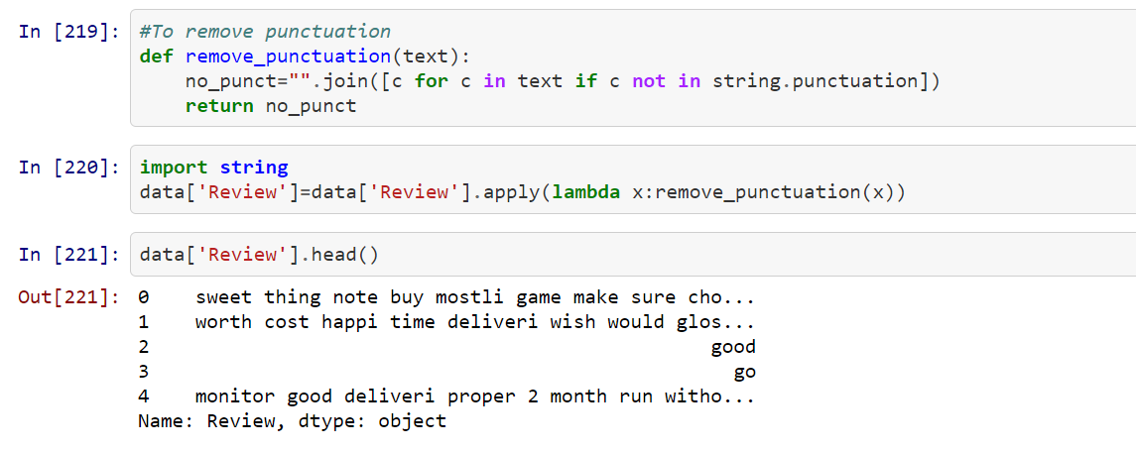
Data Preprocessing
Removing the PUNCTUATION

Slide 7
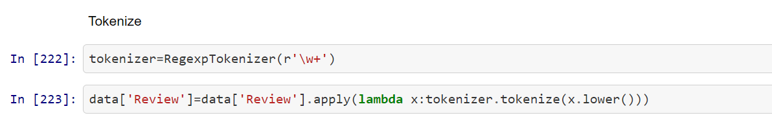
Data Preprocessing
TOKENIZE

Slide 8
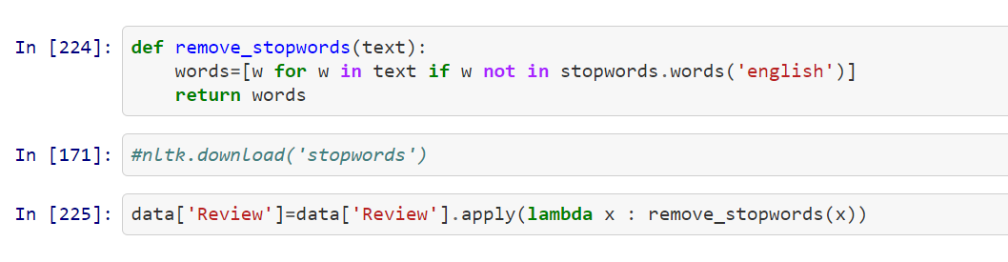
Data Preprocessing
Removing the STOP WORDS IF ANY

Slide 9
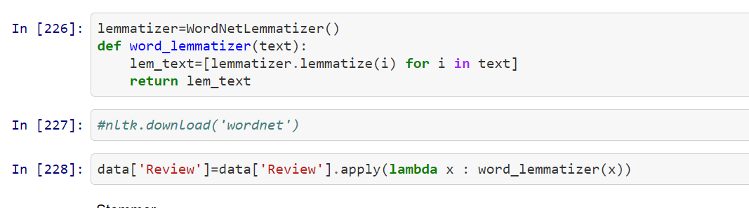
Data Preprocessing
STEMMING AND LEMMATIZING

Slide 10
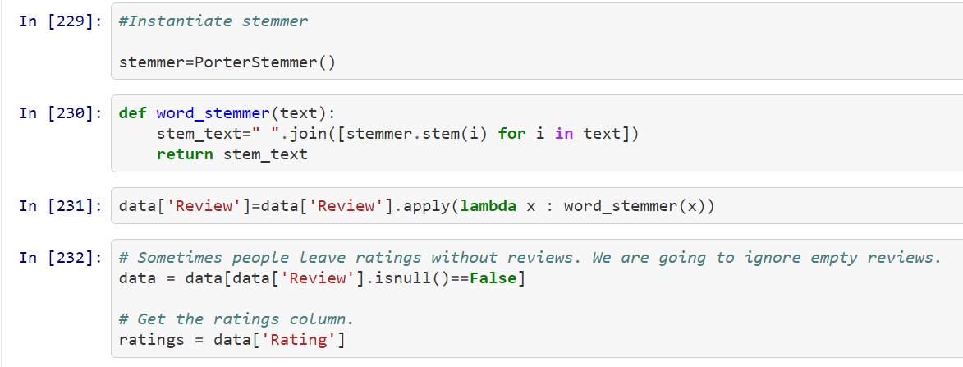
Data Preprocessing
INSTANTIATE STEMMER

Slide 11
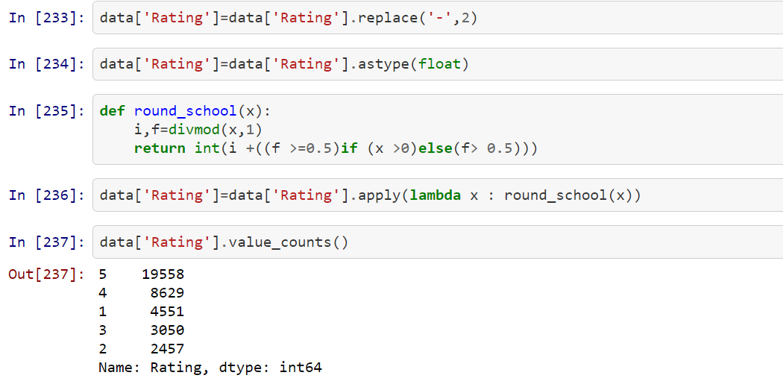
Data Preprocessing
Rounding off the ratings to make sure they are in numbers 1,2,3,4,5

Slide 12
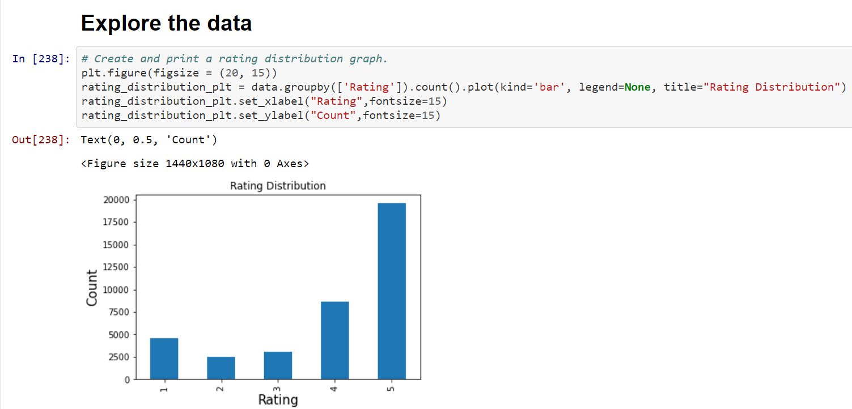
Visualization

Slide 13
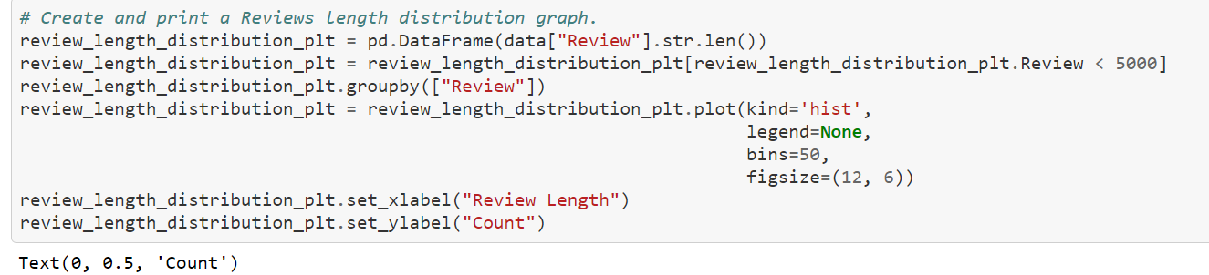
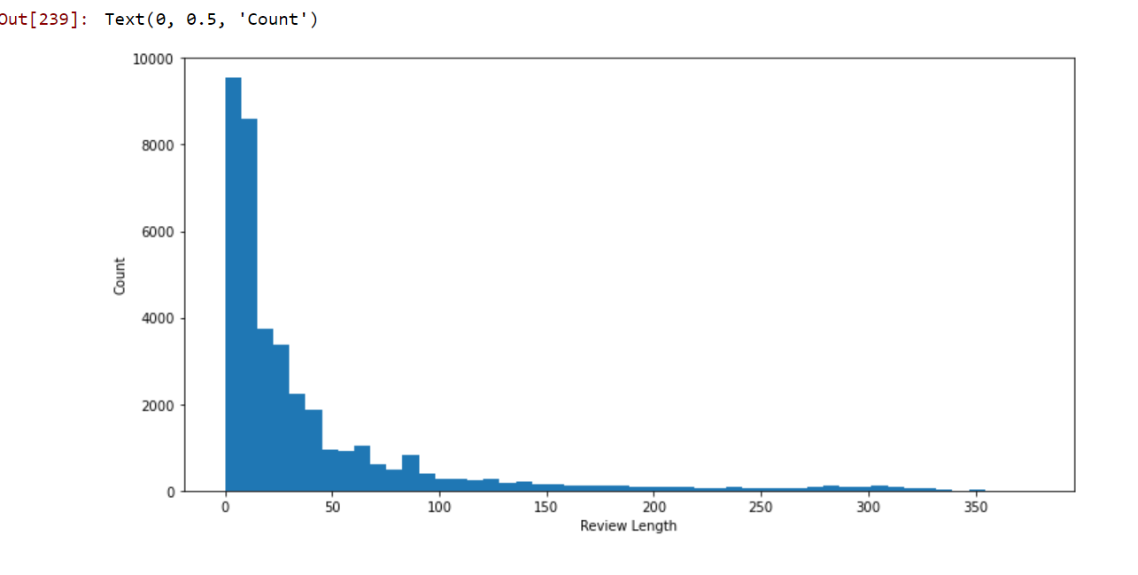
Visualization

Slide 14
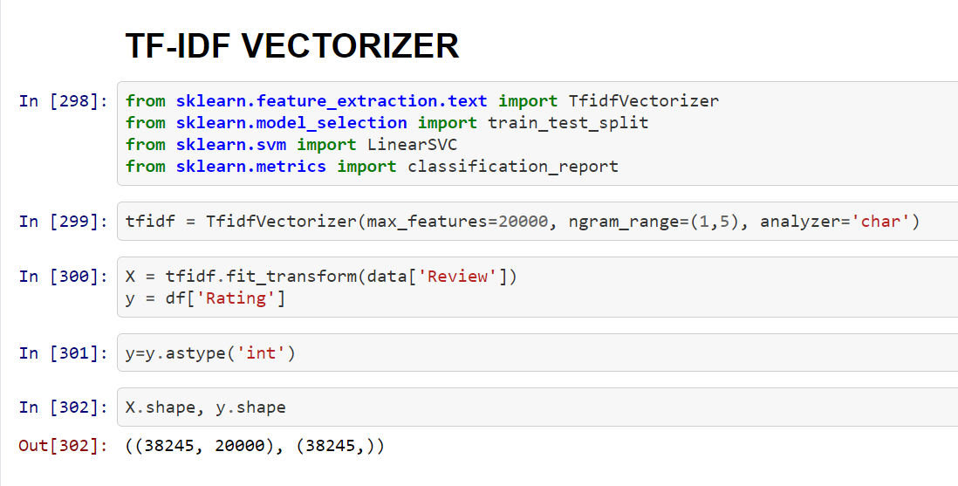
Converting text data to vector

Slide 15
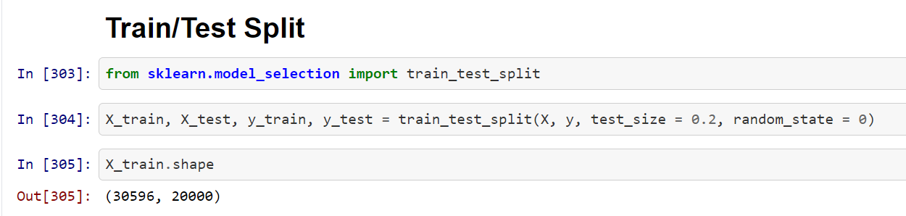
DATA Preparation for MODEL BUILDING

Slide 16
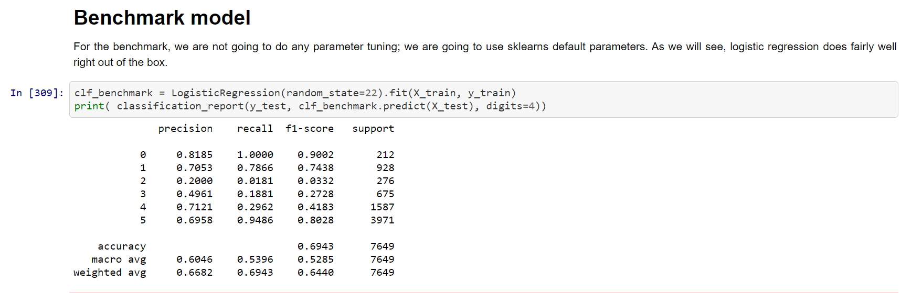
MODELLING

Slide 17
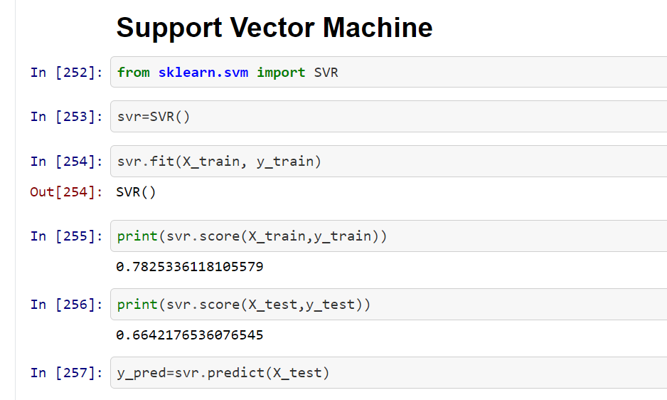

Slide 18
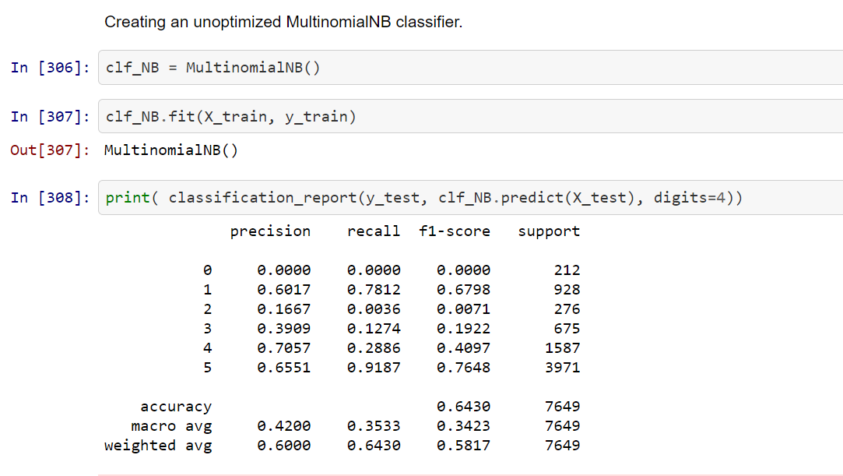
MULTINOMIAL NB

Slide 19
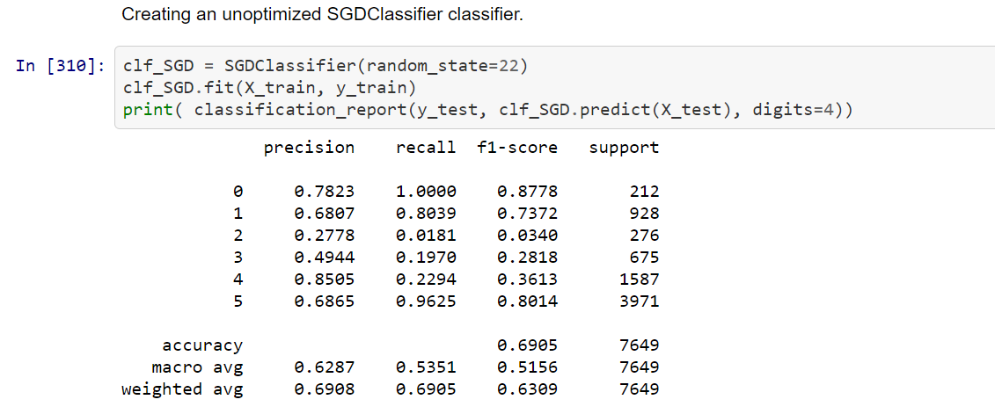
SGD Classifier

Slide 20
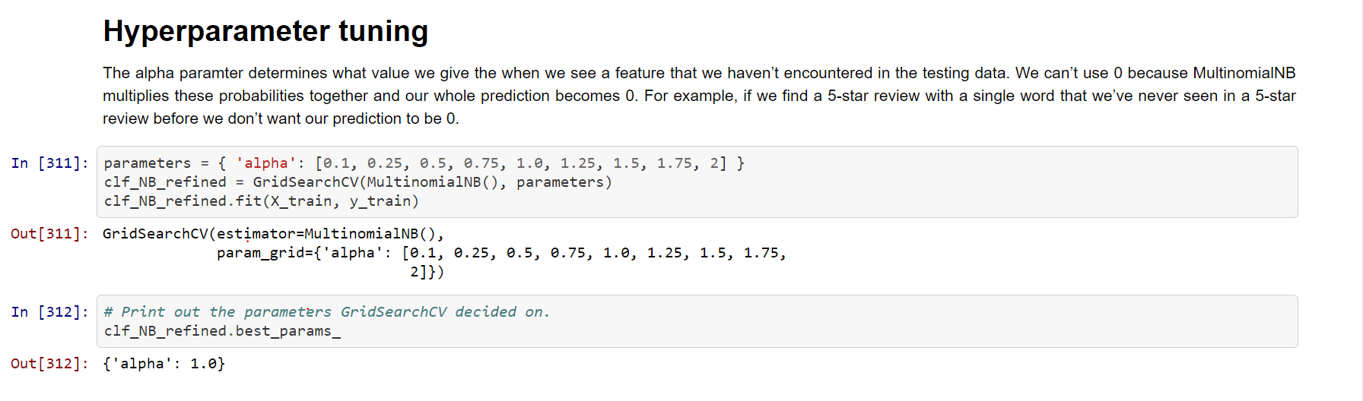
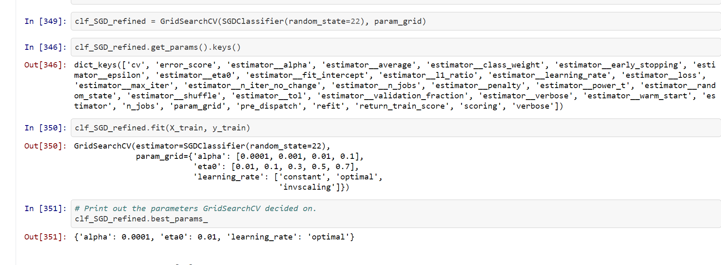
HYPERPARAMETER TUNING

Slide 21
METHODOLOGY
To create this model I took the following steps:
1. The data was downloaded and cleaned.
2. Features were extracted from the review text.
3. The data was split into testing and training sets.
4. A benchmark classifier was created.
5. Several classifiers were trained against the data using automated parameter tuning.
6. The models were tested against the testing data.
7. The models were compared using F1-scoring as a metric.

Slide 22
Model Building
Different types of Model As specified below have been run :
Logistic Regression
Multinomialnb classifier
SGD CLASSIFIER

Slide 23
Modelling
Splitting the data into training and test datasets

Slide 24
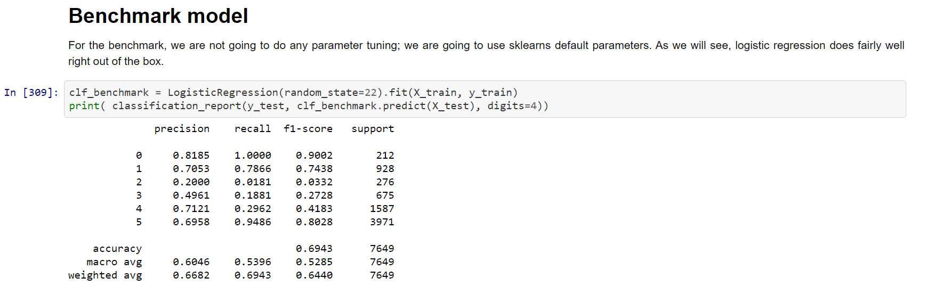
Logistic Regression

Slide 25
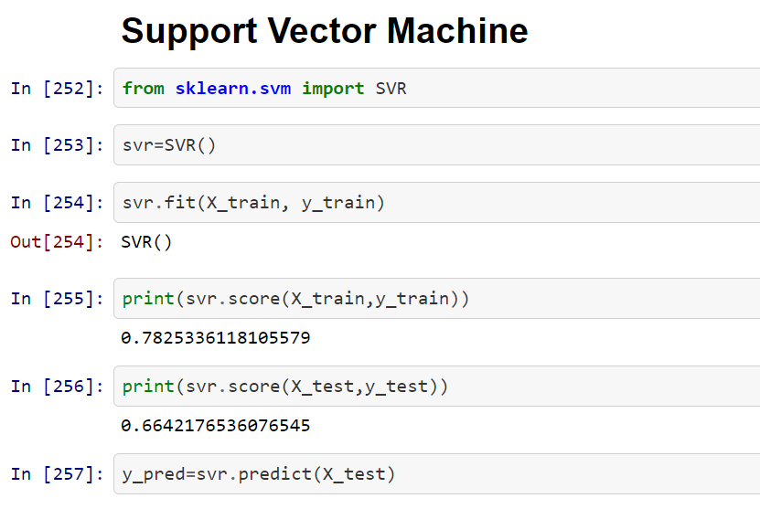
Support vector machine

Slide 26
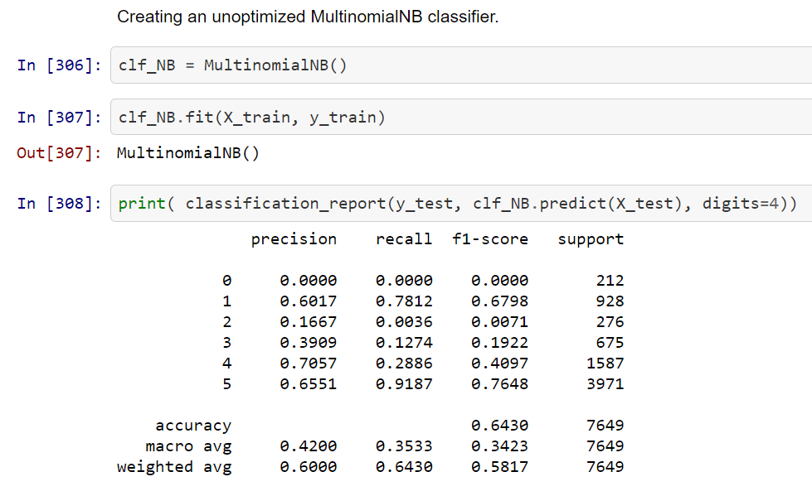
MULTINOMIALNB CLASSIFIER

Slide 27
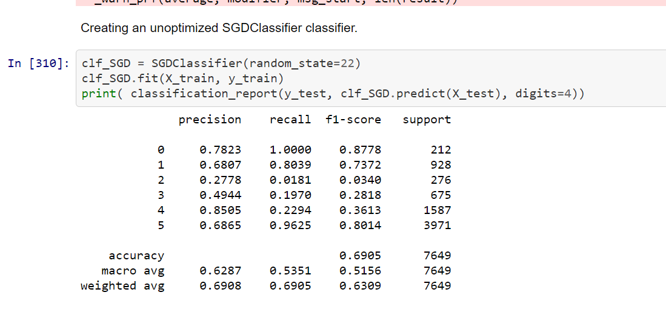
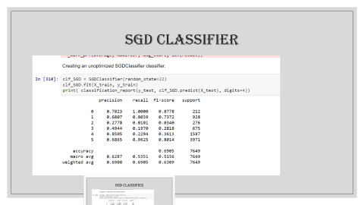
SGD CLASSIFIER

Slide 28
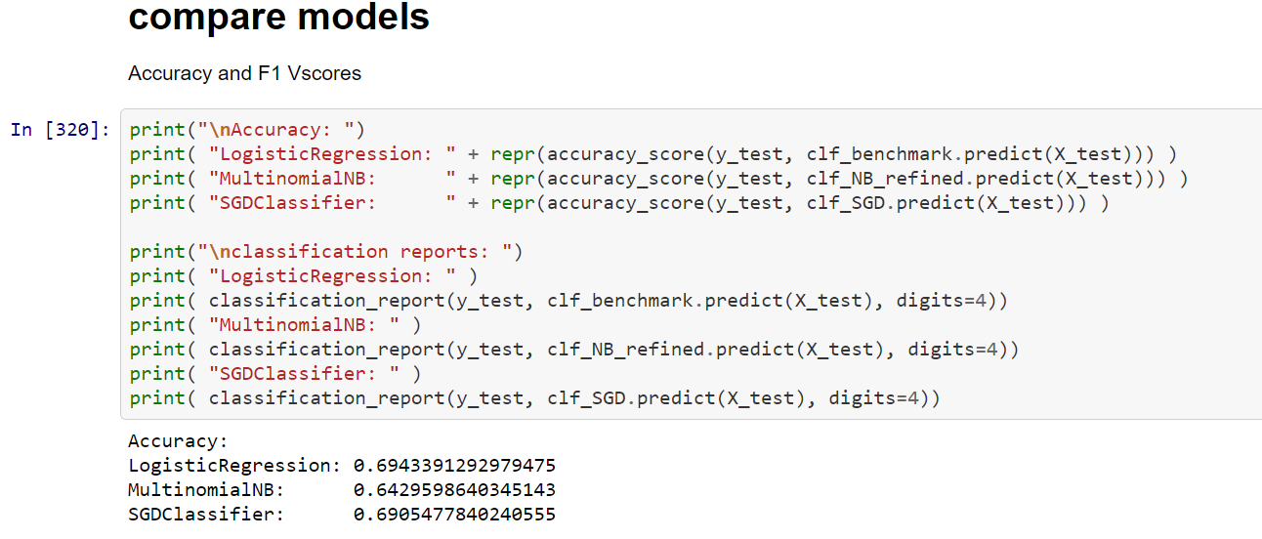
COMPARING to find the best model

Slide 29
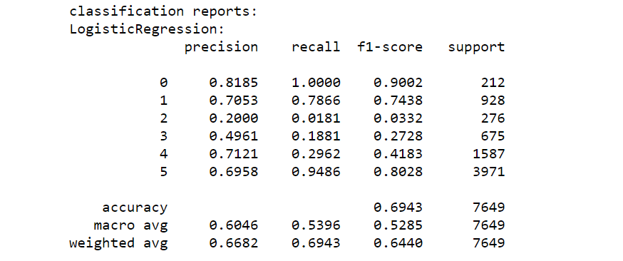
Further MODEL EVALUATION WITH CLASSIFICATION REPORTS

Slide 30
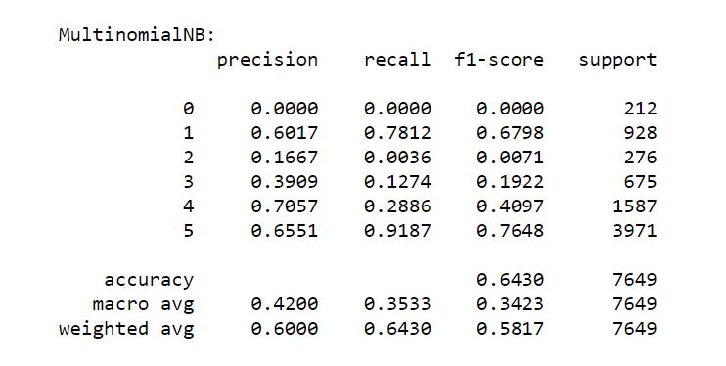
CLASSIFICATION REPORTS

Slide 31
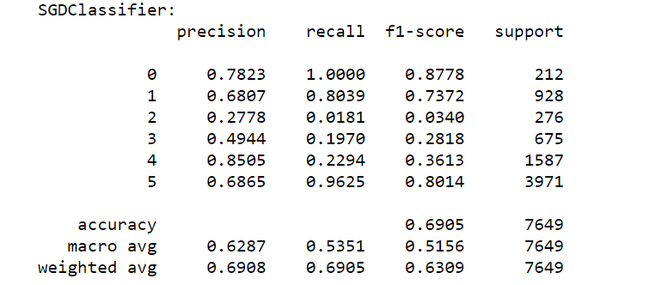
CLASSIFICATION REPORTS

Slide 32
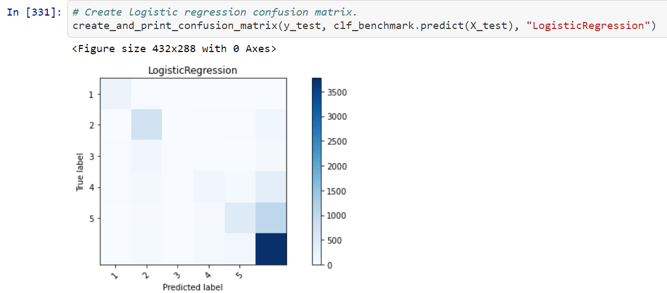
CONFUSION MATRICES

Slide 33
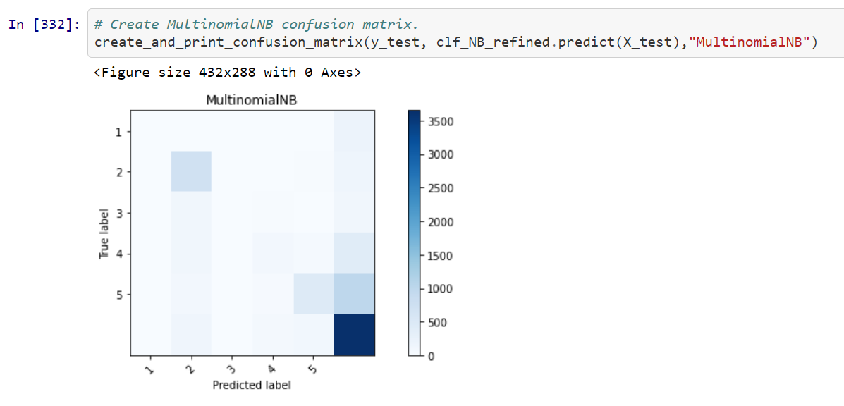
CONFUSION MATRICES

Slide 34
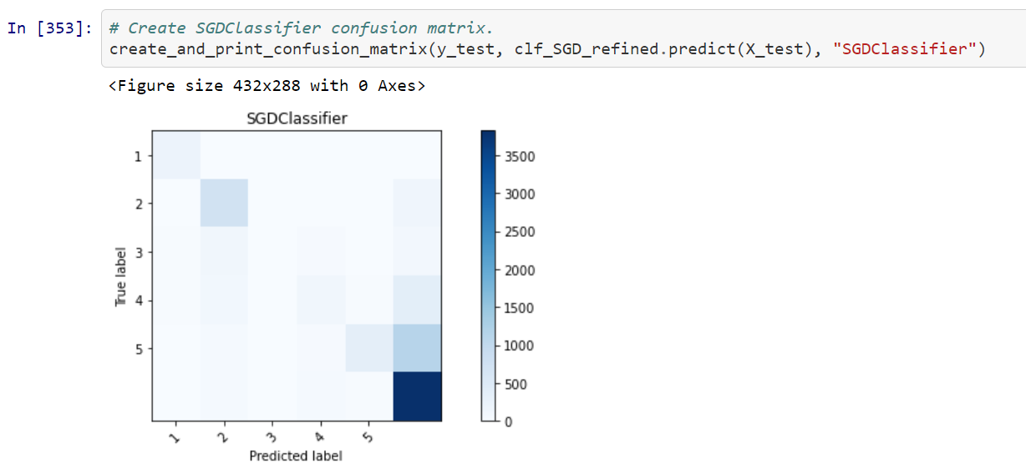
CONFUSION MATRICES

Slide 35
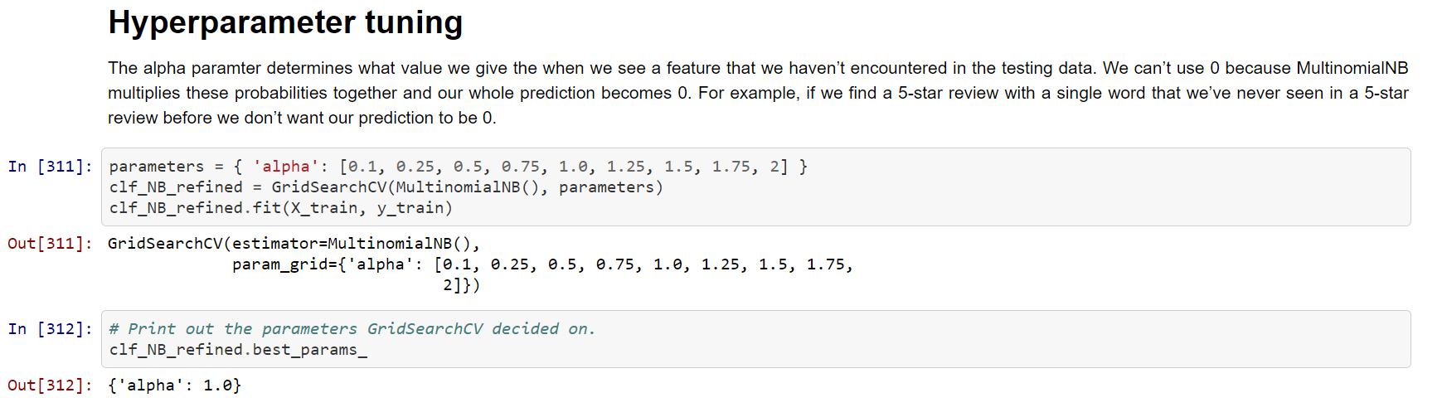
HYPERPARAMETER TUNING

Slide 36
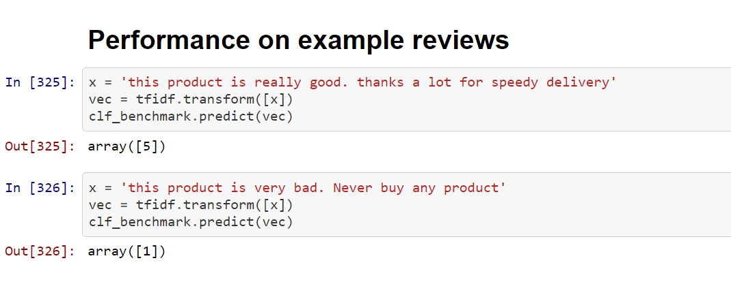
Example of working model on sample Reviews

Slide 37
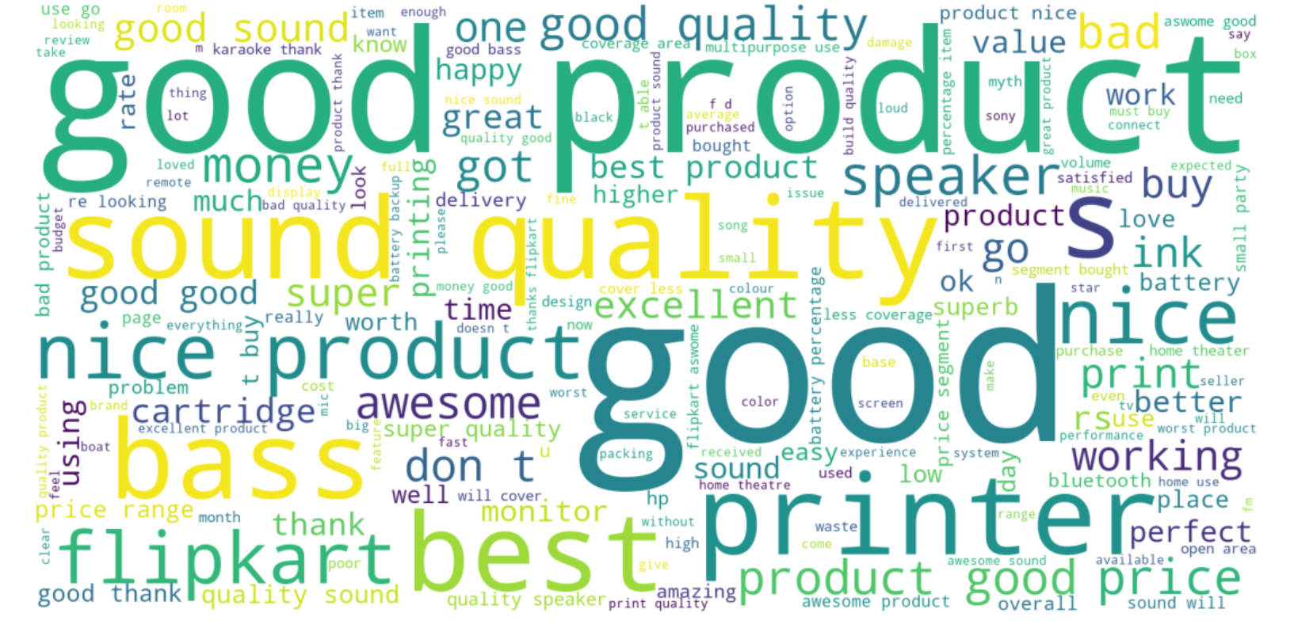
CONCLUSION
After comparing the three models , Logistic regression is supposed to be the best performing .
Word Cloud
When we look at the top phrases from TF-IDF we should see some similarities with the following generated word cloud:

